Slide 1
calculating Weber's ratio of an image using Python

Slide 2
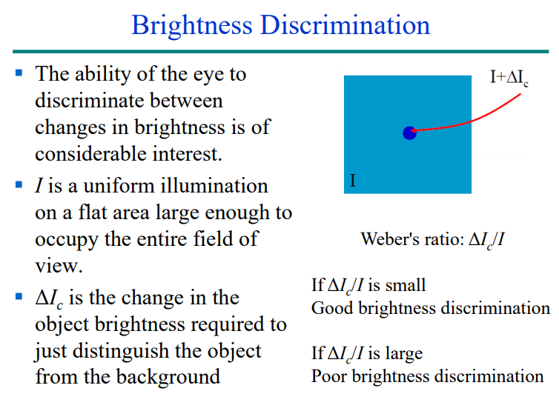

Slide 3
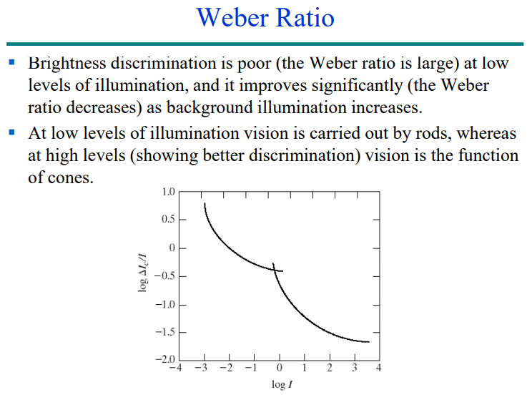

Slide 4
Objective
-To detect on which weber’s ratio we can separate the object from background
for this following brightness is used for the object.we need to determine for each seperately.
#brightness1 =1 #brightness1 =2 #brightness1 =3 #brightness1 =5 #brightness1 =20 #brightness1 =50
Pycharm IDE is use for this project

